Slide 1
People of the Holocaust
Tania Mishra, Xavier Barth, Luu Tran

Slide 2
Web demo
Notes:
The People of the Holocaust Database project derives individual stories from the pages of The United States Holocaust Memorial Museum Encyclopedia of Camps and Ghettos, 1933-1945 (hereafter referred to as the ECG) into an accessible website of information about the human impact of the Holocaust.
importance of history
Research tool, track loved one

Slide 3

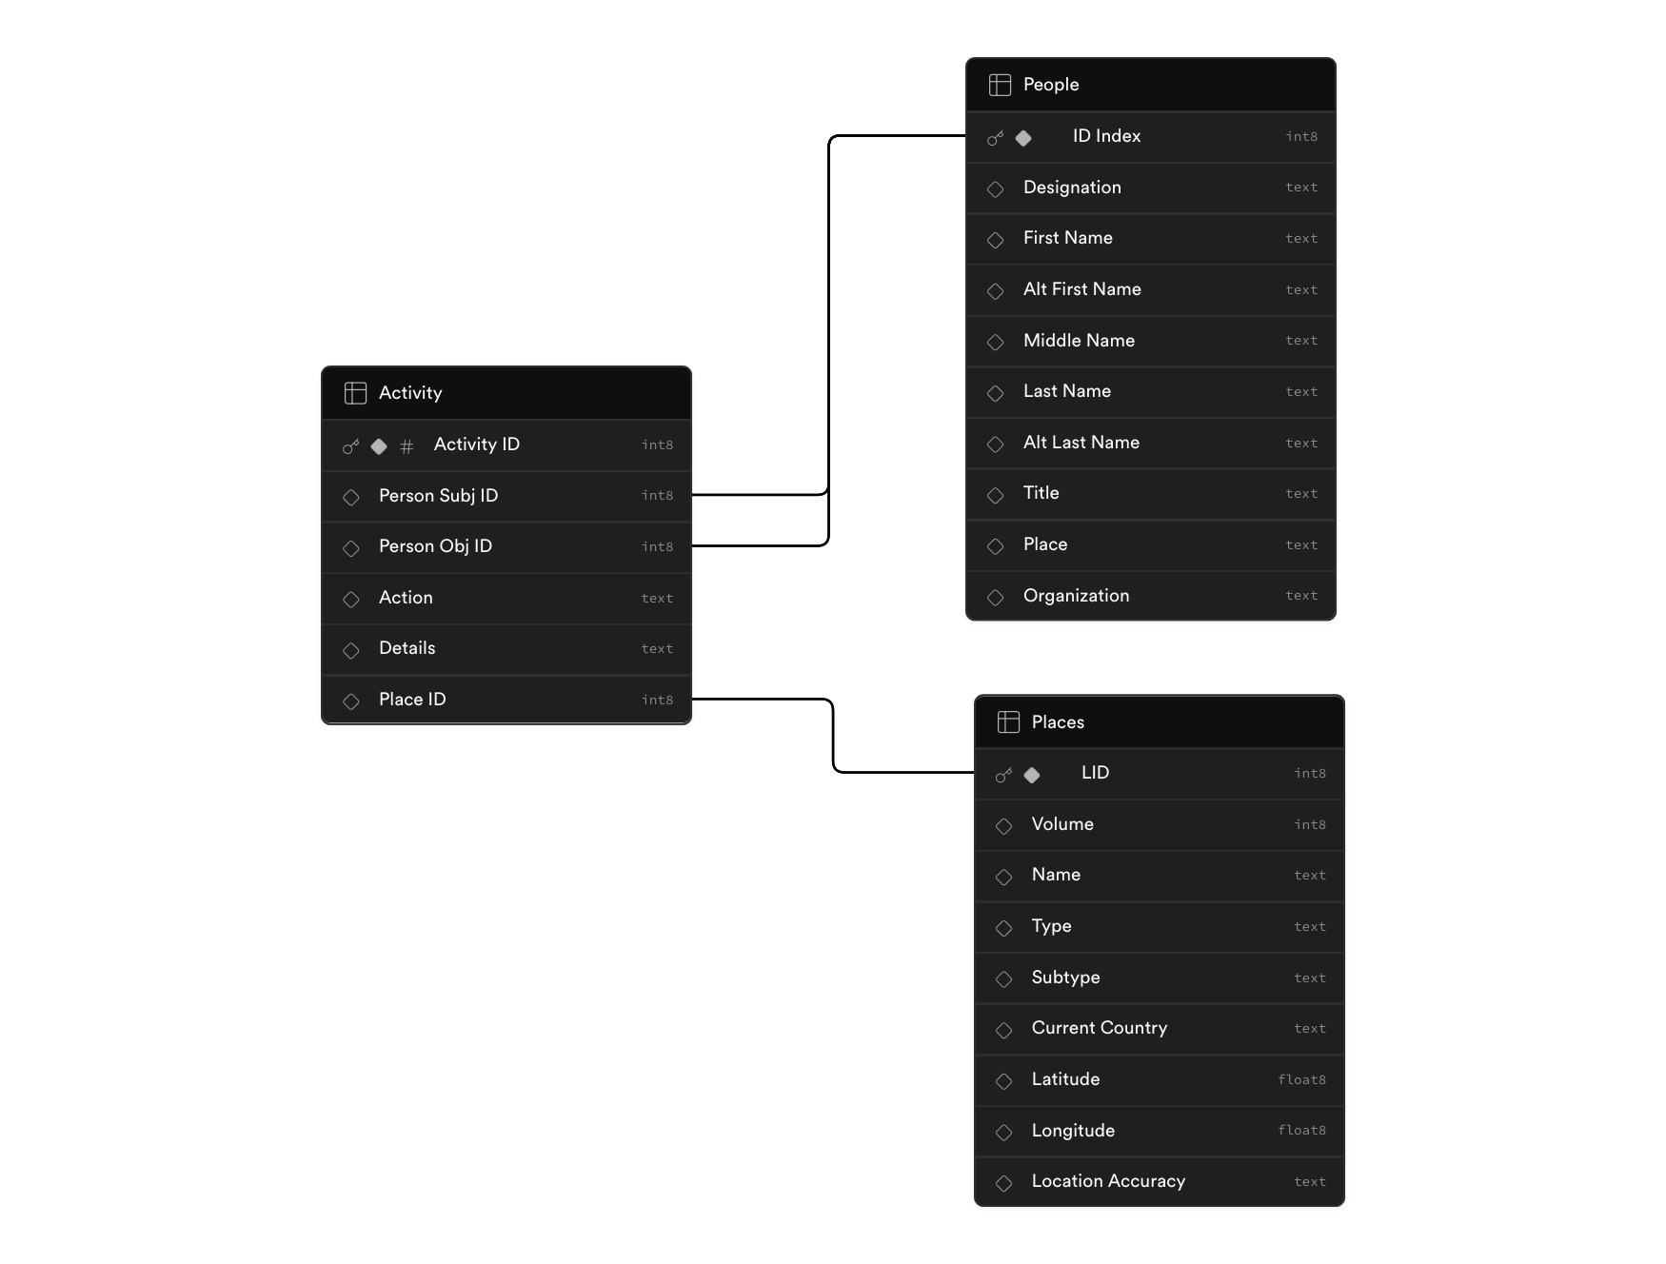
Database
Notes:
3 tables: activity, places, people
People and places come from Project Muse’s website – which hosts the ECG
Activity links people and places together, comes from the content of the ECG articles

Slide 4
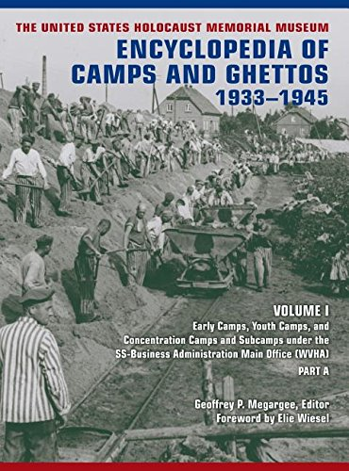
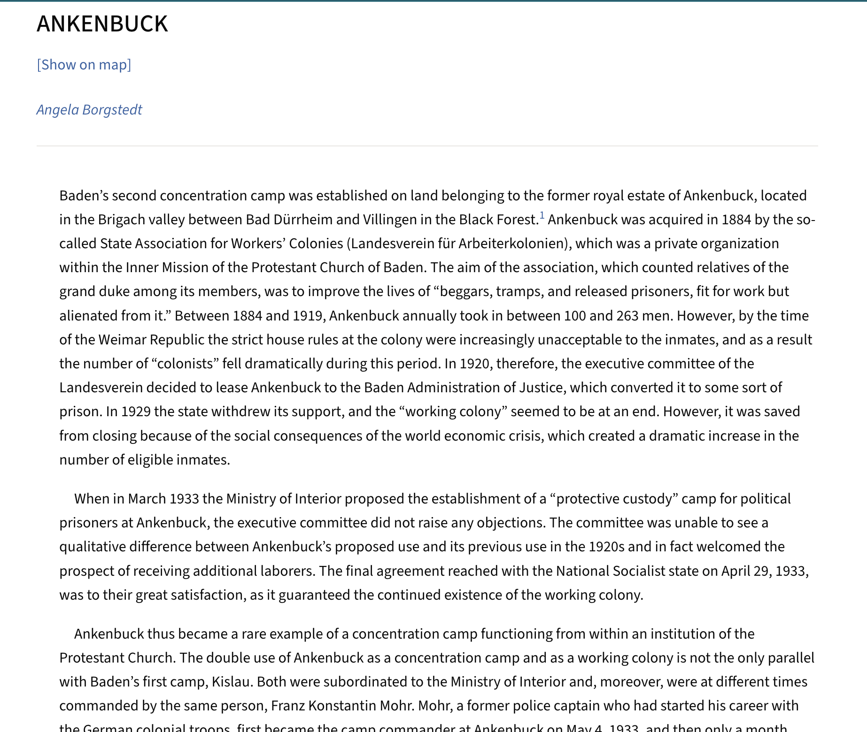

Slide 5
Interpreter
“On June 23, 1933, the former Communist member of the Freiburg Town Council, Kurt Hilbig, organized the only documented political demonstration by Ankenbuck inmates.” (ECG, document #1264, Ankenbuck)

Slide 6
Interpreter
“On June 23, 1933, the former Communist member of the Freiburg Town Council, Kurt Hilbig, organized the only documented political demonstration by Ankenbuck inmates.” (ECG, document #1264, Ankenbuck)
Person (Subject): 5796, Individual, Kurt Hilbig
Verb: Organized
Location: 14, Ankenbuck, Early Concentration Camp, Modern-day Germany

Slide 7
Interpreter – Next Steps
“On June 23, 1933, the former Communist member of the Freiburg Town Council, Kurt Hilbig, organized the only documented political demonstration by Ankenbuck inmates.” (ECG, document #1264, Ankenbuck)
Person (Subject): 5796, Individual, Kurt Hilbig, former Communist member of the Freiburg Town Council
Verb: Organized
Location: 14, Ankenbuck, Early Concentration Camp, Modern-day Germany
Date: 23, June, 1933

Slide 8
Questions?

